Slide 2
Css1 - Exercise
Create a style sheet named style.css to improve the appearance of your About Me page(create a web page that describes about your self.
Change the color of at least two elements
Change the font properties (family, size, weight, or style) of at least two elements. Some standard fonts: Arial, Arial Black, Verdana, Trebuchet MS, Georgia, Tahoma, Courier New, Times New Roman)
Change at least one other thing (e.g. background color, text alignment, etc.)

Slide 3
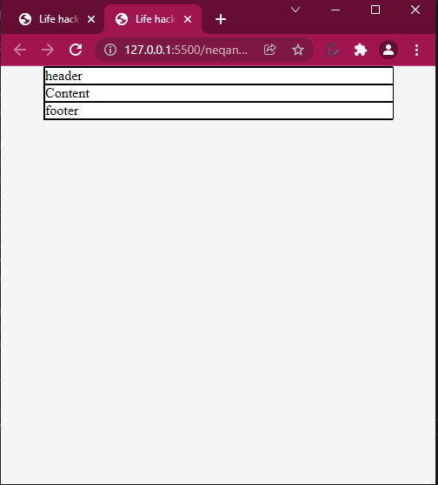
Css2 - Basic Layout
Body background color:
rgb(245, 245, 245)
Deafault color for h1, h2, h3, h4, h5, h6
Rgb (33,33,33)
Deafault color for p
Rgb (70, 70, 70)
Create wrapper box, Give it background color -> white
Under wrapper box create 3 boxes for the header, content, and footer
To visualize you can add border for each until you get familiar with the layout

Slide 4
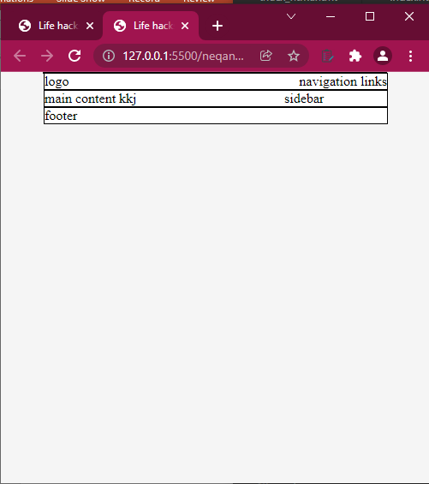
Basic Layout cont’d
Divide the header box into band and navigation sections
Divide the content box into main content and sidebar secion

Slide 5
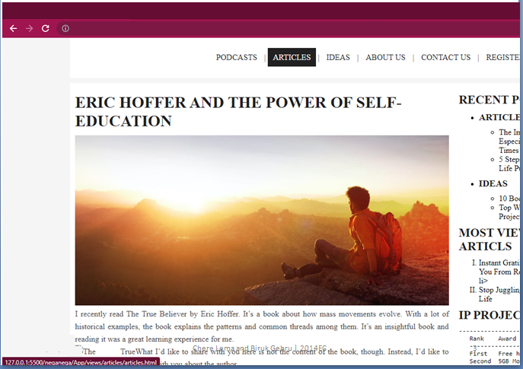
Remove all borders add for development purpose
Add margin among header, content and footer sections
Add necessary padding for each box as shown in the screen shot
Modify the navigation bar as shown above also include mouse over effect
Increase the space between paragraphs
All headings must be capitalized by default
Logo attributes must be added inside the CSS file

